Slide 1
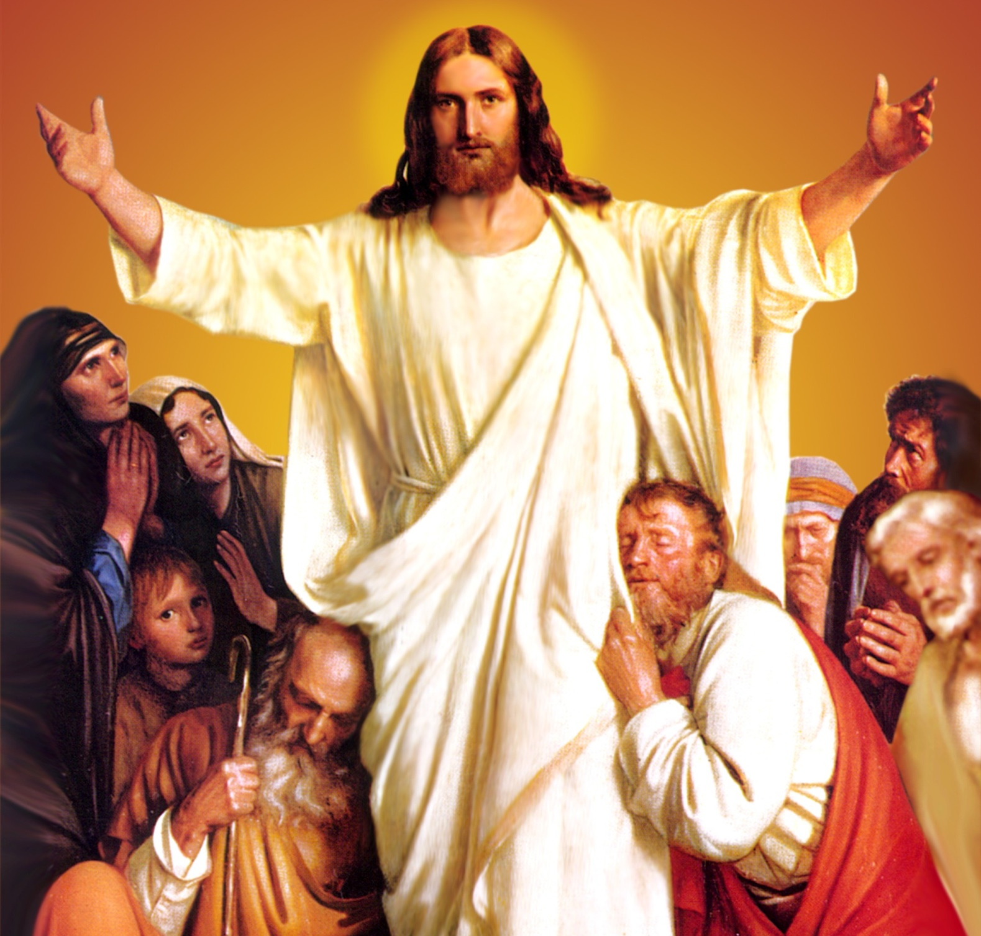
CATECHETICAL TEXTBOOK SERIES OF THE SYRO - MALABAR CHURCH
ON THE PATH OF SALVATION - 6
PEOPLE WHO
EXPERIENCED JESUS
6

Slide 2
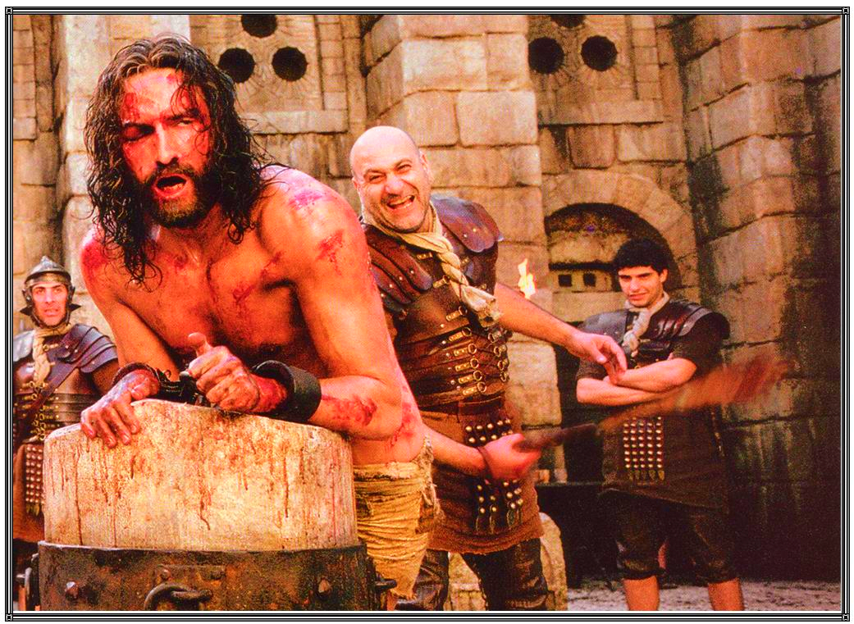
LESSON 7
JESUS WHO TOOK UPON HIMSELF OUR WOUNDS

Slide 3
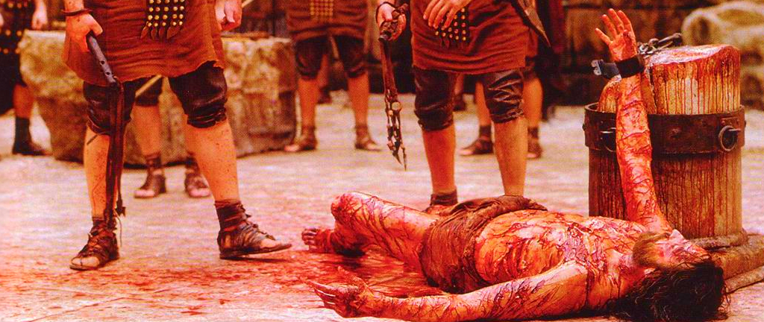
We see in Jesus the picture of the 'suffering servant' as described by the prophets. Isaiah says: “Just as there were many who were astonished at him so marred was his appearance, beyond human resemblance, and his form beyond that of mortals. He was despised and rejected by others; a man of suffering and acquainted with infirmity; and as one from whom others hide their faces, he was despised and we held him of no account. Surely he has borne our infirmities and carried our diseases; yet we accounted him stricken, struck down by God, and afflicted. But he was wounded for our transgressions, crushed for our iniquities” (Is. 52: 14, 53: 3- 5). This is the picture of the suffering servant portrayed by the prophet Isaiah. This was fulfilled in Jesus.

Slide 4
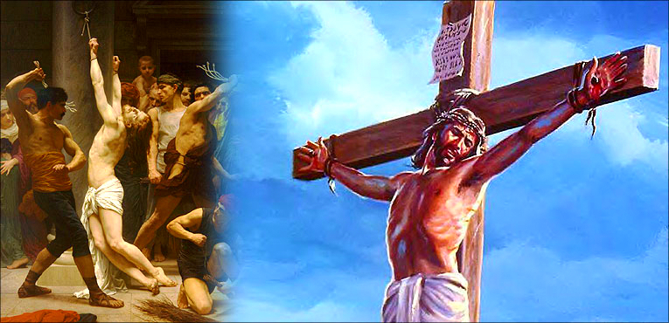
Jesus offered himself as a sacrifice in propitiation for the sins of all mankind. With the wounds of the whip all over his body, with a crown of thorns on his head and a reed-stalk in his hand, standing as a laughing stock, Jesus personified the 'suffering servant'. When Jesus died on the cross, ridiculed and scorned, all the prophecies about the 'suffering servant' were fulfilled in him.

Slide 6
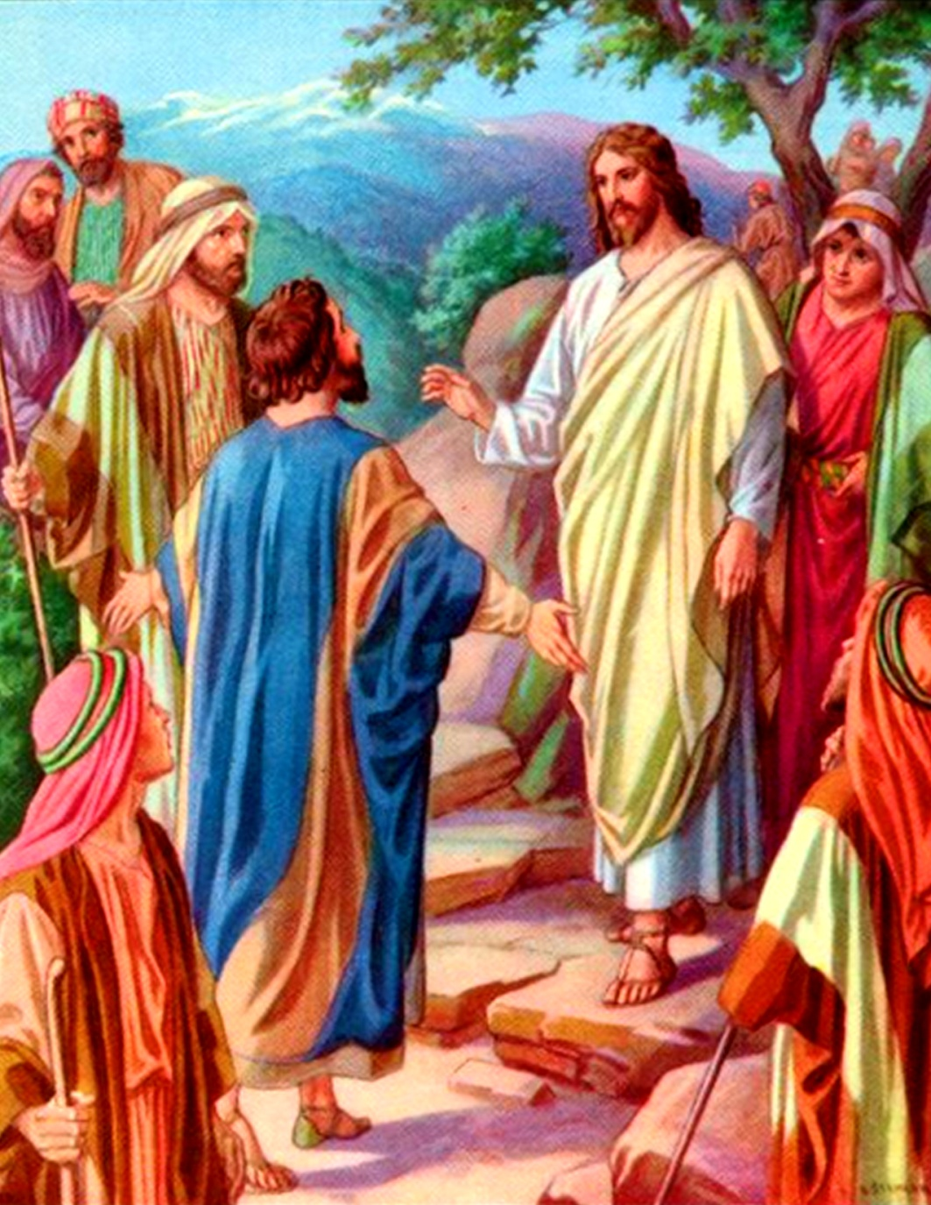
PROPHECIES OF OF THE PASSION
Jesus was aware that he was the suffering servant chosen by God the Father. That Jesus foretold His death thrice proves this. Jesus, who considered obeying the will of his Father more precious than food, did not allow any one to keep him away from the path of suffering. When his dear disciple said “Let this not happen to you”, he did not hesitate to say, “Away from me Satan”.

Slide 7
The first prophecy of Jesus about his passion was following the confession of Peter, in the region of Caesarea Philippi, saying, “You are the Christ, son of the living God”. “From that time on, Jesus began to show his disciples that he must go to Jerusalem and undergo great suffering at the hands of the elders and chief priests and scribes, and be killed, and on the third day be raised” (Mt. 16: 21). Chapter seventeen and twenty of Mathew's gospel record the repetition of this prophecy (Mt. 17: 22, Mt. 20: 17- 19). Hearing of the Prophecy of Passion, Peter took him aside and began to rebuke him saying, “God forbid it, Lord! This must never happen to you.” But Jesus turned and said to Peter, “Get behind me, Satan! You are a stumbling block to me, for your thoughts are not divine but human” (Mt. 16: 23).
The evangelists Mark and Luke also have recorded Jesus' prophecy regarding his passion. Through these words Jesus made clear his conviction that his mission was to achieve the salvation of the world through his passion, death and resurrection.

Slide 8
THE SERPENT RAISED IN THE DESERT
Prophecies of the passion of Jesus are recorded in Mathew, Mark and Luke. But John presents this through a symbol. “And just as Moses lifted up the serpent in the wilderness, so must the son of man be lifted up, so whoever believes in him may have eternal life” (Jn. 3: 14- 15). An incident during the exodus of Israel through the wilderness is alluded to in this allegory. God led the people of Israel, stretching out His hands of protection over them, giving them water, manna, and quails. He travelled with them as a pillar of cloud by day and a pillar of fire by night. In spite of all this, the people murmured against Moses and against God. “Why did you bring us out of Egypt, to perish in the wilderness? No bread or water is available here. And we detest this miserable bread” (Num. 21: 5). God heard the people quarrelling with Moses. He sent fiery serpents among them. Many died of their bites.

Slide 9
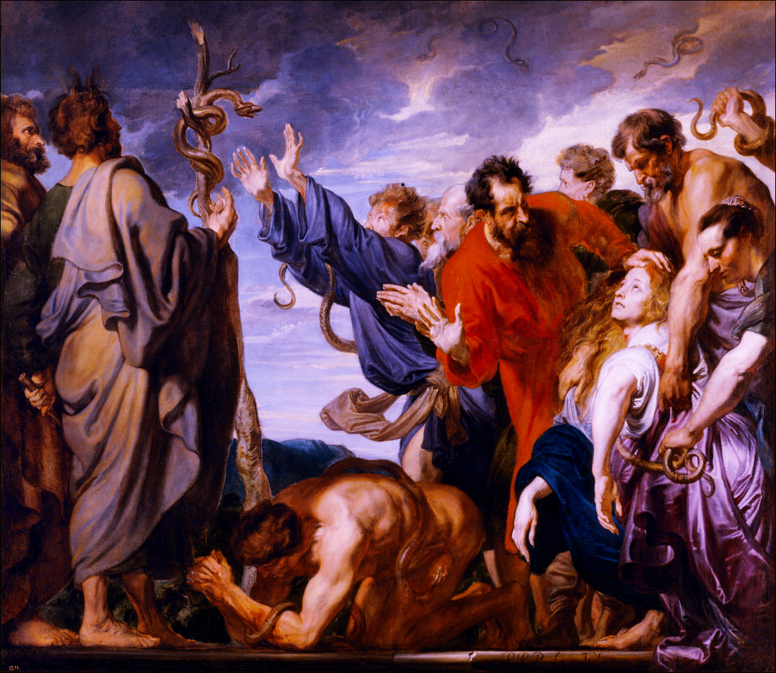

Slide 10
The Israelites realized that speaking against God and Moses was wrong. They went up to Moses, confessed their fault and begged to be saved from the poisonous snakes. God said to Moses, “Make a bronze serpent and raise it up on a staff. Those who are bitten shall escape death if they look at this serpent” (Num. 21: 8). Moses did as God commanded. Those who looked at this bronze serpent survived.
Jesus was raised up on the cross to offer salvation from eternal damnation to those poisoned by sin. Those who look at him with hope and trust receive life. Thus the symbol of the bronze serpent found new meaning in Jesus. Jesus said, “When I am lifted up from the earth, I shall attract all people to myself” (Jn. 12: 32). Our saviour Jesus, who was raised up on the cross in Calvary, keeps attracting all people to himself. Let us express our love for Jesus, who took upon himself all our wounds and pain in atonement for our sins. Let us proclaim him as our saviour.

Slide 11
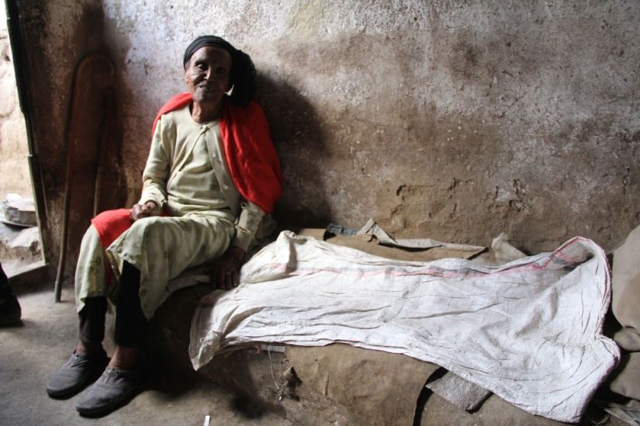
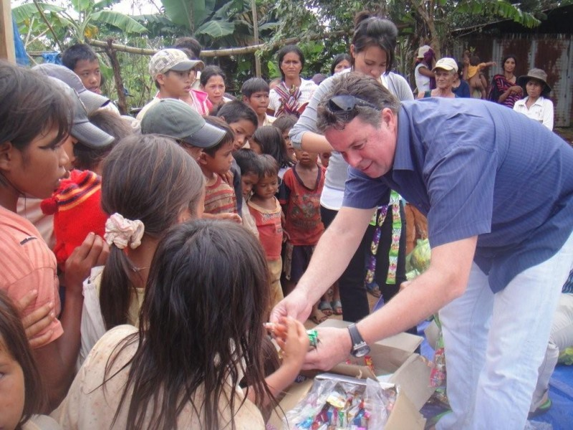
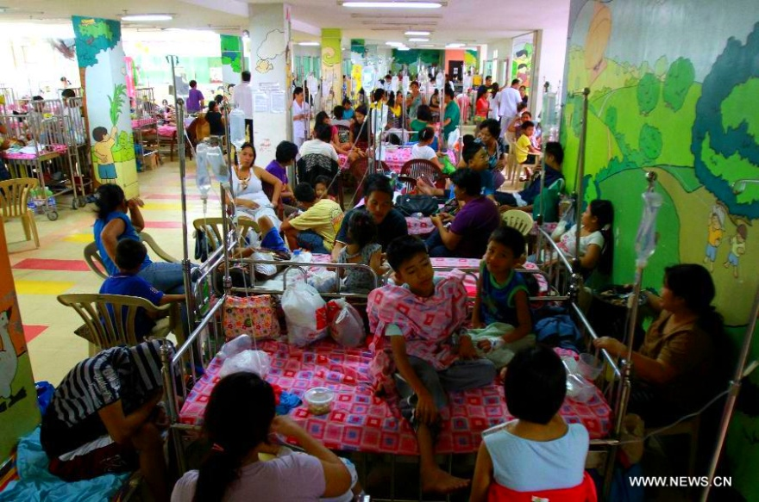
As disciples of Christ it is our duty to comfort those in our church and community who suffer from sorrow and pain. We have to accomplish this mission on the individual and social levels. It is by participating in such services that we can be witnesses to Jesus who took our wounds upon himself.

Slide 12
Let us pray
O! Jesus , who became the sacrifice for our salvation , help
us to crucify with you, the evil desires of our life on the cross.

Slide 13
Read the word of god:
Isaiah 52:13 - 53:12

Slide 14
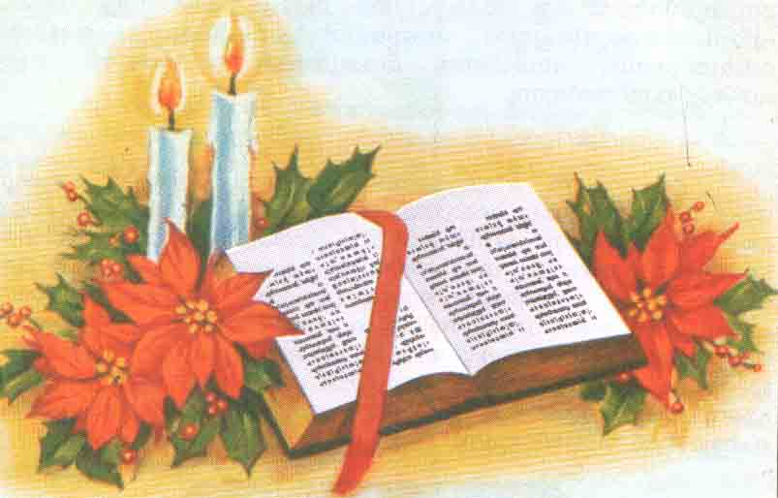
WORD OF GOD FOR GUIDANCE
"He was wounded for our transgressions and crushed
for our iniquities" (ls. 53:5)

Slide 15
LET US DO:
Find out and write three examples of prophesies fulfilled in Jesus regarding the suffering servant of the Old Testament.

Slide 16
MY DECISION
Jesus suffered for me on the cross. Like Him, I shall
bear my sufferings for the good of others.

Slide 17
LET US Find out the answer
1. Write the sentence which touched you most from the narration about the suffering servant.
2. How did Jesus fulfil in himself the prophecies about the suffering servant in the Old Testament?
3. How can we understand that Jesus had the awareness that he was the Suffering servant appointed by the Father?
4. When did Jesus say to Peter, "Satan, get behind me"?
5. How was the symbol of the bronze serpent realized in Jesus?

Slide 18
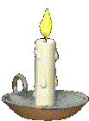
Thank you

